Slide 1


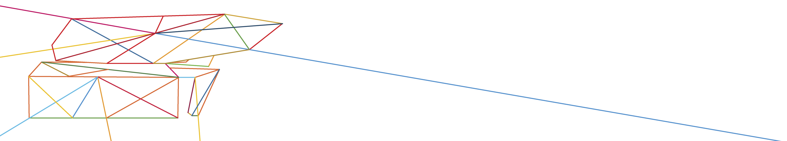
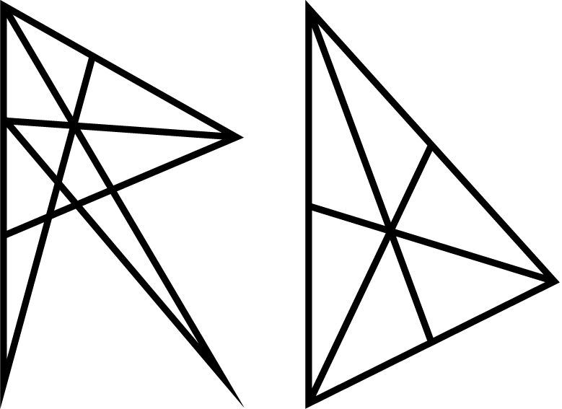
PORTS AS MATERIAL-MANAGERS
Jan Leyssens
CEO
Regenerative Design

Slide 2
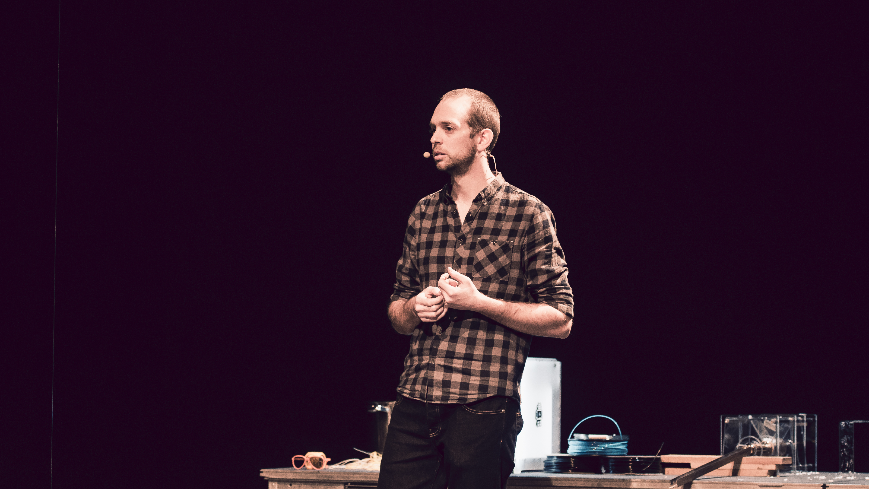



© Boumediene Belbachir
Notes:
Hello,
My name is Jan Leyssens,
I’m the founder and CEO of the design agency Regenerative Design
And co-founder and designer at the social and circular design collective switchrs.
I’d like to talk about what role ports could play in the circular economy, especially in relation with rethinking the strategic positioning of ports and the role of local communities therein.

Slide 3
© Studio Roosegaarde
Notes:
Since you can’t have the port without the sea or the ocean, and also to underline, if that was still needed, the importance of things like this. Like the World Ports Sustainability Program, I would like to begin this presentation with a beautiful piece and a warning written by Kate Marvel who’s a writer and climate scientist called “We should never have called it earth”:
“We should never have called it Earth. Three quarters of the planet’s surface is saltwater, and most of it does not lap at tranquil beaches for our amusement. The ocean is deep; things are lost at sea. Sometimes we throw them there: messages in bottles, the bodies of mutinous sailors, plastic bags of plastic debris. Our sewage.
We, all of us, are at the mercy of the ocean.
To be a climate scientist is to be an active participant in a slow-motion horror story. These are scary tales to tell children around the campfire. We are the perfect, willfully naïve victims: We were warned, and we did it anyway.
We continue to burn fossil fuels and the gases they make continue to trap heat, warming the air, the land, the shallow seas. The heat is mixed deep into the ocean, a long slow slog to equilibrium. There is no way to stop it.
What do I tell my son? A monster awaits in the deep, and someday it will come for you. We know this. We put it there.

Slide 4
@awkwardtroy
Notes:
As a designer, my work focusses mainly on strategic business design and policy innovation in the field of circular economy and social innovation, so I am honored that I can take the stage today at the launch of the World Ports Sustainability Program and especially happy to, hopefully, inspire you on maybe the most important, and definitely the most difficult and complex of the three sessions today which is “Communities & Innovations”.
Don’t get me wrong, both “Climate & Energy” and “Future Generations” are not going to be a walk in the park either, but mastering the processes that are underlying in innovation, and understanding that our wicked challenges are always interconnected in the fabric of society and communities is what in my opinion makes the difference between the organizations and companies that are interested in Sustainable Development Goals, and those that are actively working on making a structural change.
And, in case that wasn’t clear yet, the challenges we’re facing are structural, are complex, and are real. And more than ever we’re being confronted by these challenges.

Slide 5
© Stockholm Resilience Center
Notes:
For me, this diagram right here is an essential one. Not only because it shows the SDG’s and how they are linked, but because it shows something much more important. It shows the relation between society, economy and our planetary boundaries.
Because in the end, sustainability is pretty straight forward.
We, just like most other animals, group ourselves in communities, in herds, in tribes, in a society. And all interactions within that society is what we like to call the economy.
So, in order to make that work on a sustainable way, we have to create an economy that, at all times and at all costs, remains in touch with the society it’s serving, and at the same time, takes into account our planetary boundaries.
Ideally that system is also resilient enough to take a disruption and a beating or two.
And we don’t have to look that far to see that at this moment, our economy is far from resilient, far from connected with society and, let’s be honest, far from healthy. Not for the planet, but even not for us, the users and creators of the rulebook.
So the big challenge then is: how can we create, how ca we design an economical system that can do that? A system that can both take a beating, stays within the limits of planet earth, and provides everyone with a basic humane level of wellbeing?
Don’t get your hopes up to much just yet, I do not have the definitive answer to those questions. Yet. but I’m convinced that the circular economy will probably be part of the solution.

Slide 6
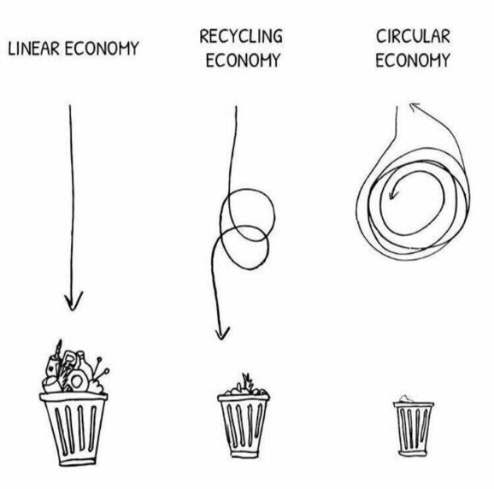
© Vlaanderen Circulair
Notes:
Over CE

Slide 7

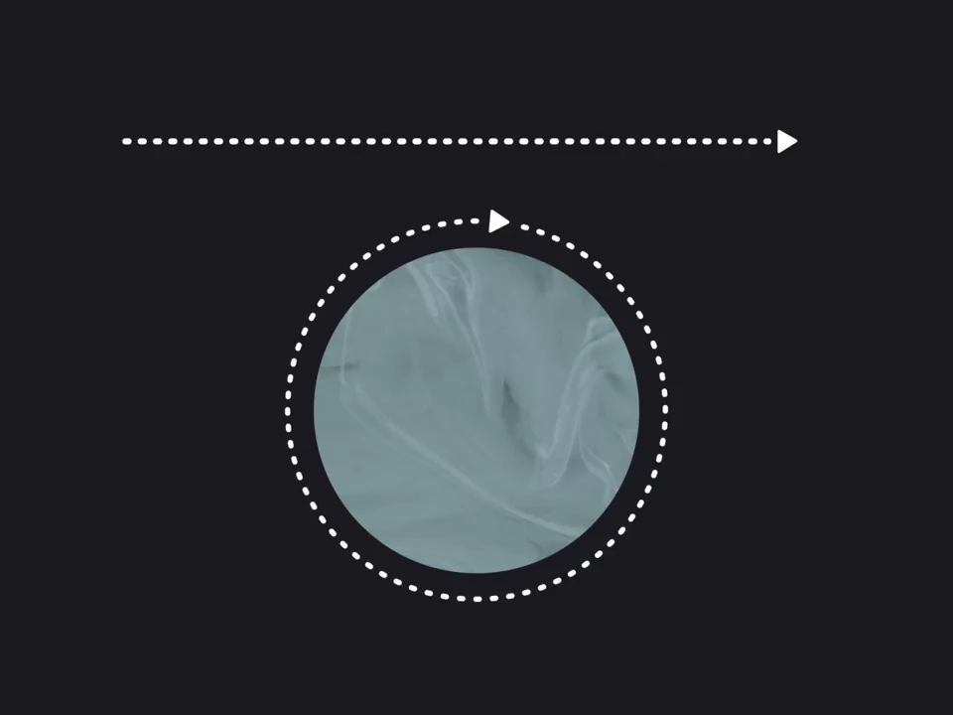
DEGENERATIVE
Take
Make
Waste
Re-Use
Re-Take
Re-Make
REGENERATIVE
© Circular Design Guide
Notes:
In a circular economy we try to make the shift from a take-make-waste, degenerative economic model, where we only take and never give back,
to a take, make, use, and eventually re-take, re-make, re-use model which ideally will be regenerative by design.

Slide 8
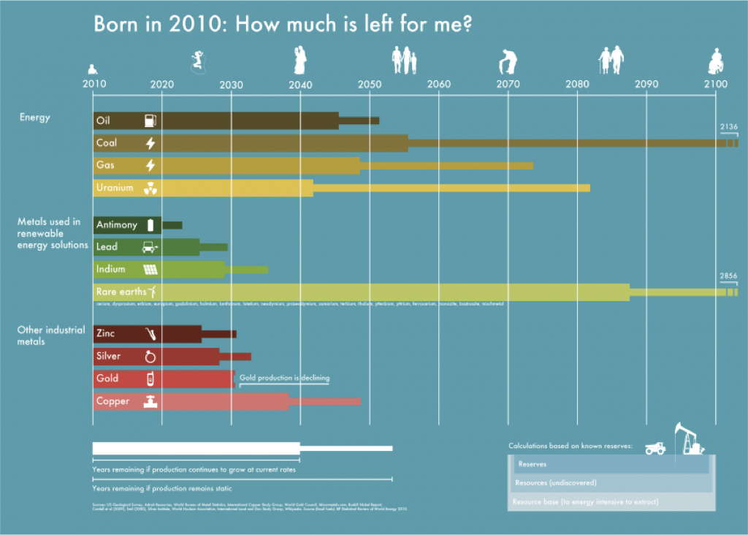
© Vlaanderen Circulair
Notes:
Noodzaak CE

Slide 9
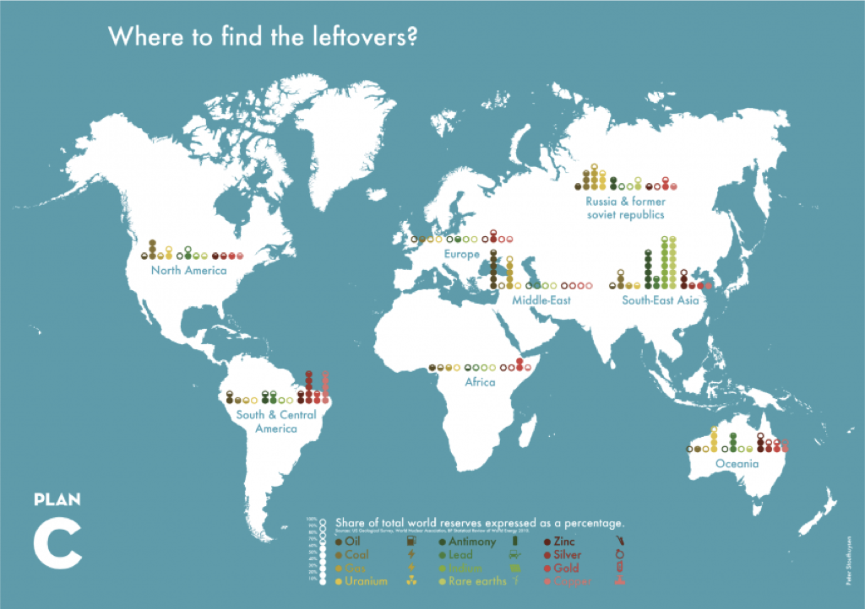
© Vlaanderen Circulair
Notes:
Noodzaak CE

Slide 10
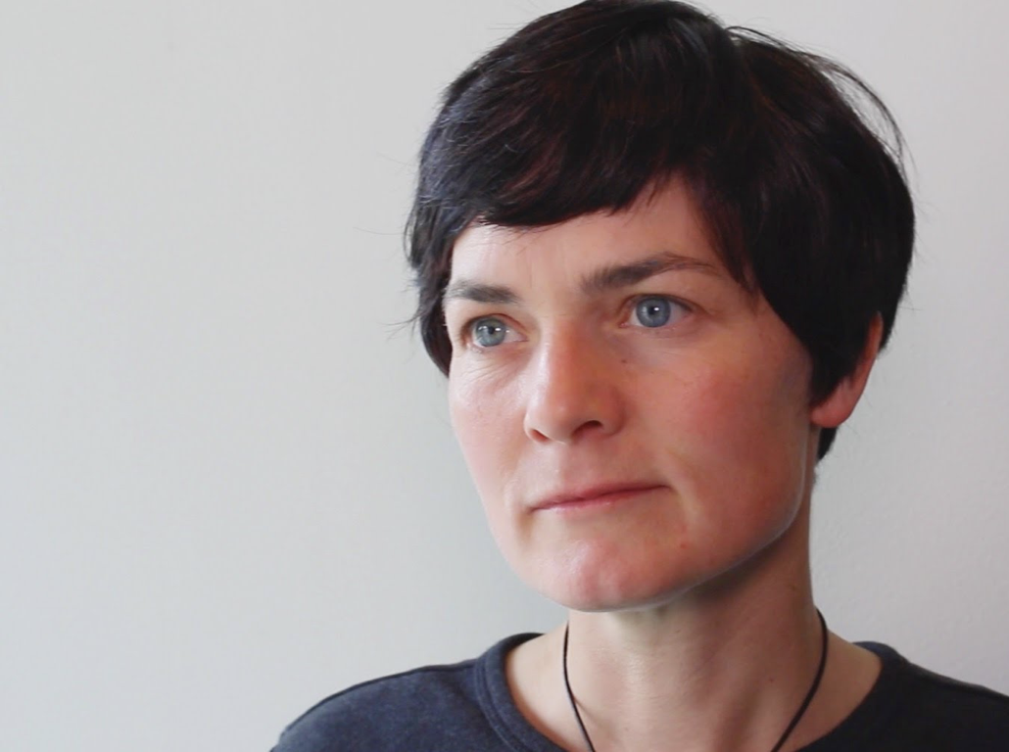
“RETHINKING THE FUTURE:
IT IS A PROFOUND CHALLENGE, AT THE END OF AN ERA OF CHEAP OIL AND MATERIALS TO RETHINK AND REDESIGN HOW WE PRODUCE AND CONSUME;
TO RESHAPE HOW WE LIVE AND WORK, OR EVEN TO IMAGINE THE JOBS THAT WILL BE NEEDED FOR TRANSITION.”
- Dame Ellen MacArthur

Slide 11

© Circular Design Guide
Notes:
I won’t go too much into detail on how that closing of loops works, but would instead like to focus on an extremely important part of circular economy: working together.
Meeting each other over the boundaries of companies and even sectors.
The circular economy will create local jobs, resilient jobs even if the companies involved understand that sustainability, just like innovation, is not an add-on.
But a healthy Circular economy demands that everybody chips in. Organizations, companies, NGO’s, policy and most of all communities.
Any economic system is an aggregation of all the transactions that happen. And the Circular Economy is in the first place always a local economy.
If the communities aren’t a part of this shift, there will be no transactions in it. If there are no transactions, there will be no economy.
The time that companies and CEO’s could pretend that their only job is to create jobs, welfare and some sort of economical transaction is over. Either you understand that you, as a company, are part of society, and have to take up your responsibilities in it, or you will be gone within the next 15 years.
It’s that simple.

Slide 12
@kjarret
Notes:
In a circular economy, materials go around in flows. Once a product is outdated, we try to reuse as much of its materials and components in a new product. Understanding that waste if above all a design error. Waste is just material in the hands of the wrong person.
And the design of these products that go around in circles is one thing. But maybe more important, especially at the tipping point we’re at, is the management of products, materials, waste stream and recycled material flows.
And the management of these flows is a tricky one. We will probably need some sort of centralization of both data and the materials themselves to make everything work.
And as far as data is concerned, we’ve got that pretty much covered. Digitization of value chains and storing very detailed and specific product information is easier than ever, especially with technologies like blockchain.

Slide 13
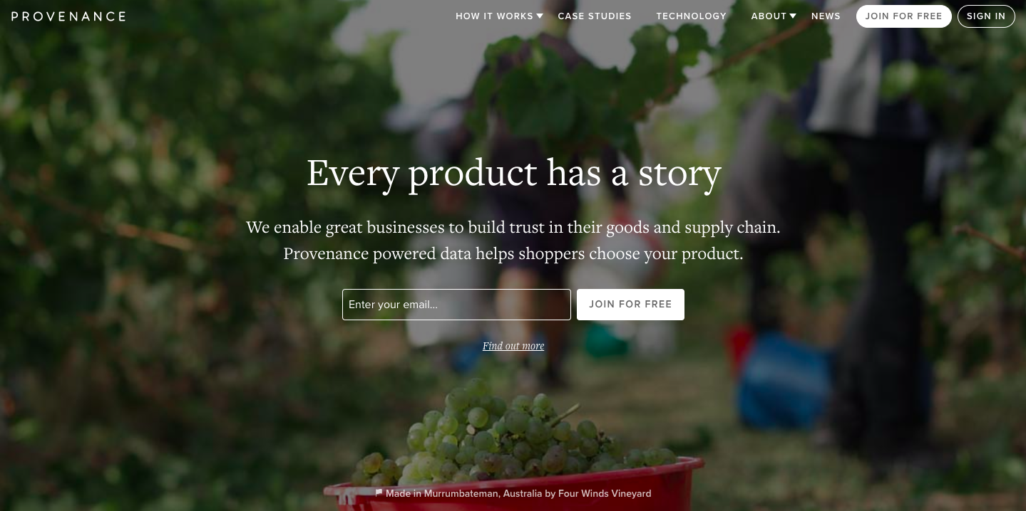
Notes:
A great example of that is Provenance, a start-up that uses blockchain to completely open up the proces of what were not so long ago incomprehensible strings of stakeholders.
On provenance you can go through the entire value chain of not just a production process, but of that one specific bottle of wine that you bought, and look up every single step of the chain.

Slide 14
© RAU
Notes:
But also in architecture we’re seeing more and more innovations when it comes to knowing what materials are put into a structure.
For example the Aliander building by Thomas Rau, who perceived the building as a material bank, where every item and material that was put in there, is there on a temporary base, even if temporary means 100 years.
In the end, if the building is to be demolished or renovated, every single piece of material remains the responsibility of the contractor or company that put it there, and has to be taken back by the them.

Slide 15
@chuttersnap
Notes:
And especially in this last example we can see why places like ports are so interesting for the circular economy.
Because, when we’re talking about materials, and material flows, we need some sort of local, physical centralization of materials. Of stuff. Some sort of aggregated critical mass that makes it interesting for a company to come over and re-use a material again.
I strongly believe that the future of the ports will not be solely in storage and transshipments, but more likely in managing materials. Distributing to both local manufacturers and recyclers in and around the ports, or to ship residual flows of mono-materials to a port or country specialized in the recycling of or production with that specific material.

Slide 16
@Hermez777
Notes:
Because, let’s be honest. It makes more sense in keeping your electronic waste here and retrieving all precious rare earth materials from it, than shipping it to the other side of the world, and dumping it there, to only later dig it back up and ship it back here and get those rare earths.
Which by the way is what we’re doing right now when we’re talking about our electronic waste.

Slide 17
Ports as material-managers
@chuttersnap
Notes:
So, Ports as material managers instead of referrals.
This will not only make the ports as an economic player more resilient in the ever changing economic framework, but it will also ensure that circular economy stays where it needs to stay, on a local level. And that’s also where the communities come in.
And apart from local jobs and activity, the circular economy also holds in it one potentially game changing aspect: labour as an added value rather than a cost. The moment materials become as, if not more, important than the services we build around them, the knowledge of handling physical things will become an added value you’d like to invest in rather than outsource it.
A smart collaboration between automatization and new a new labour-focus will not only create local jobs, it wil create relevant, desirable local jobs.

Slide 18
@thevernon
Notes:
The circular economy needs centralized places in which materials are aggregated, and I am convinced that ports all over the world are ideal to become those places because of their interconnectedness with both each other and the surrounding communities.
So my challenge for all of you here today is to explore your role within that model of the circular economy and the communities living and working in that economy.
Thank you.

Slide 19
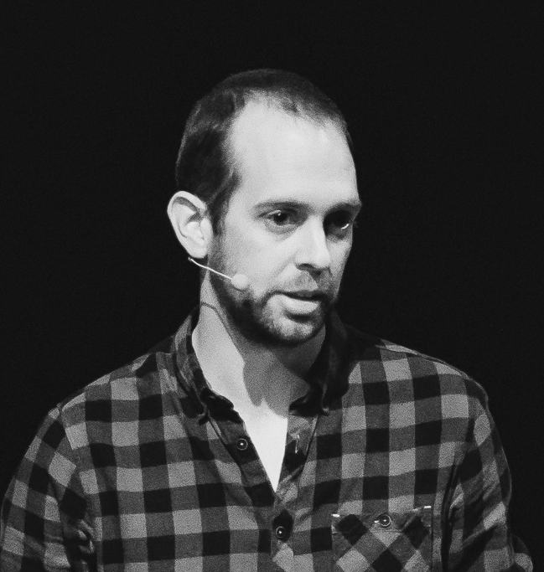



jan@switchrs.com
@contextdesigner

