Slide 1
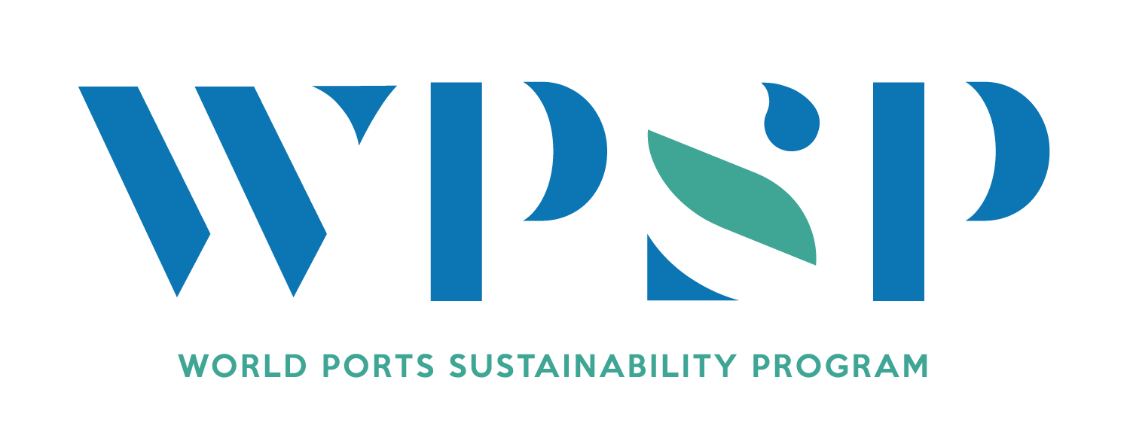

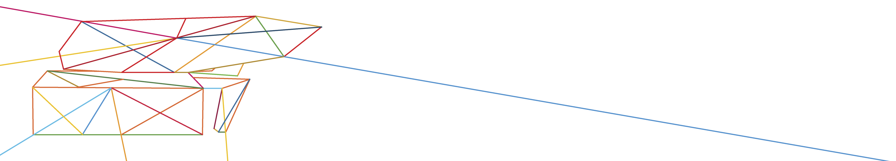
Port Sustainability and Future Generations
Cleopatra Doumbia-Henry
President
World Maritime University

Slide 2
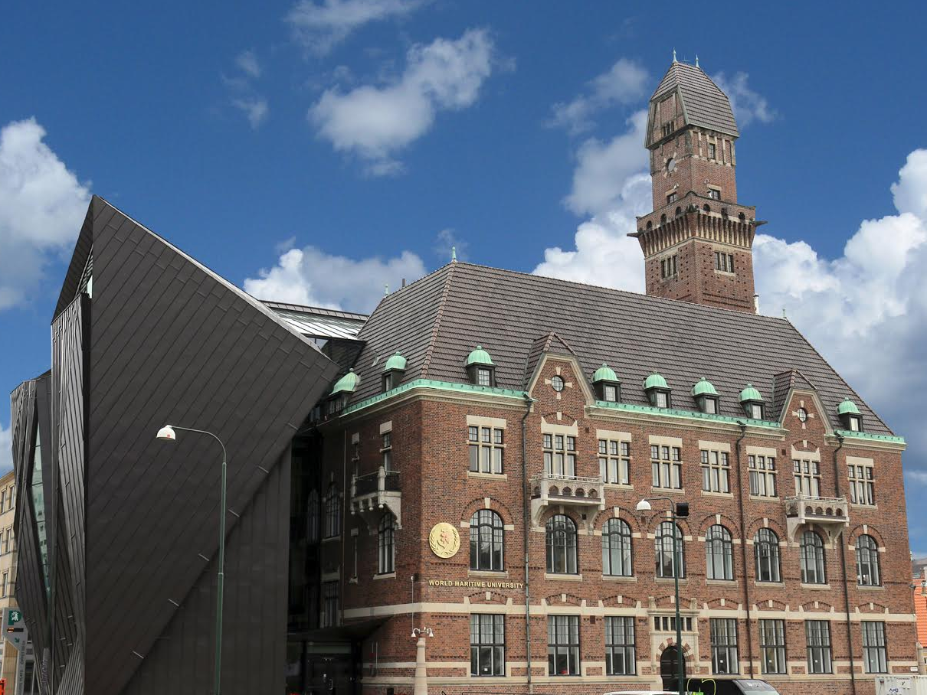



World Maritime University
A Specialized UN Institution in Sweden
Notes:
Tetd
uj7j7

Slide 3
Port Sustainability and Future Generations
Dr. Cleopatra Doumbia-Henry
President
World Maritime University
22 March 2018, Antwerp, Belgium

Slide 4
Outline of Presentation
The Central Element of the UN 2030 Agenda is PEOPLE - the current and future generations
Ports contribution to the achievement of the UNSDGs
The Key to the Success of the UN 2030 Agenda - EDUCATION
Working with Future Generations for Port Sustainability – Role of WMU
Equal Opportunities for Maritime and Port Education
Providing cutting-edge knowledge for Future Managers on Sustainable Maritime Energy Management
Providing Maritime Professionals with A Broader Vision of the Oceans

Slide 5
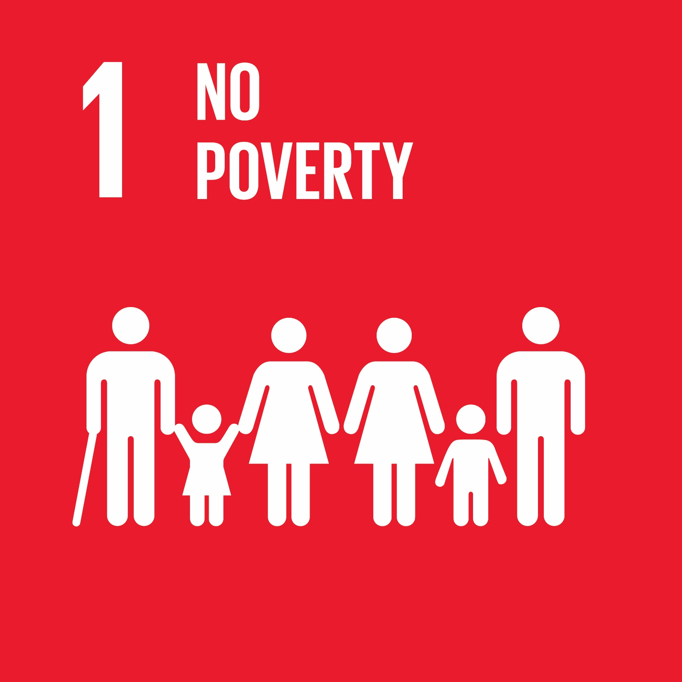


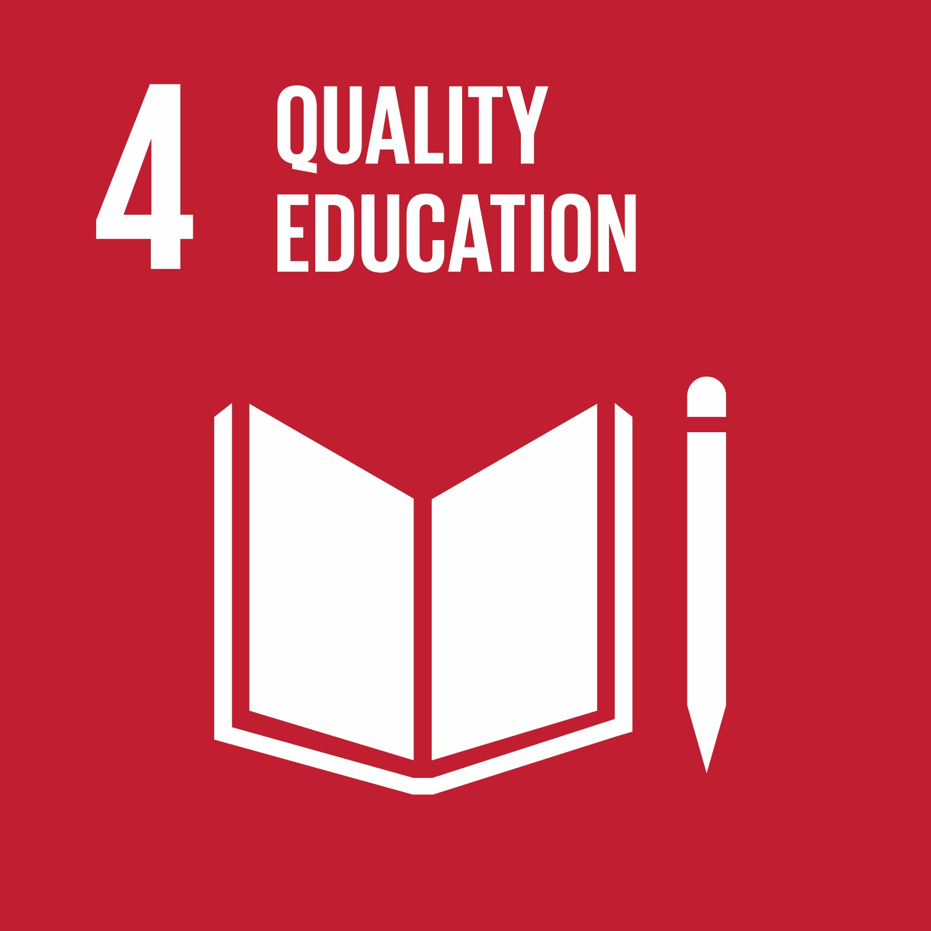
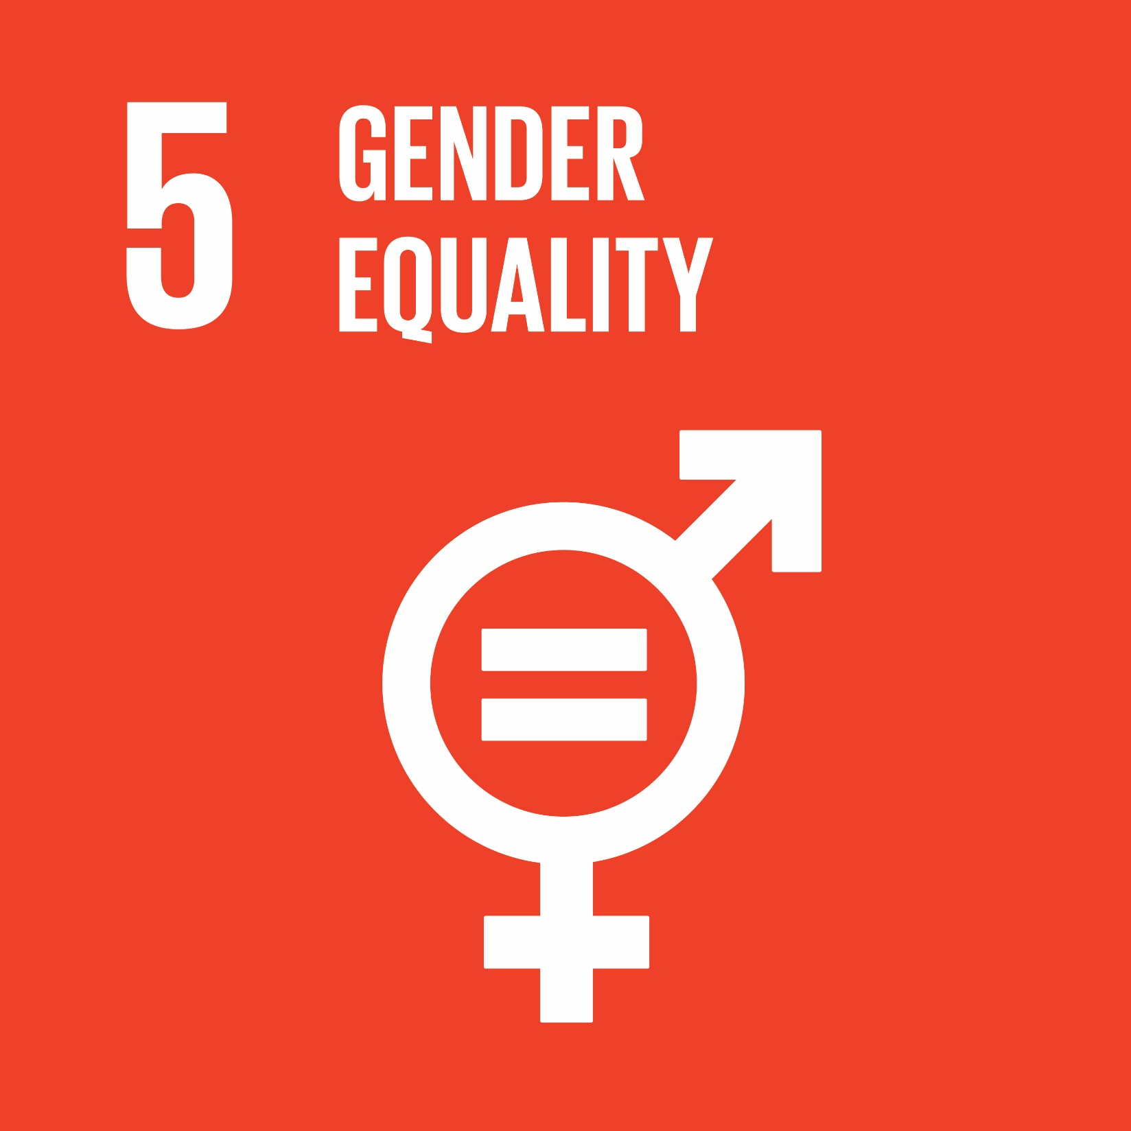
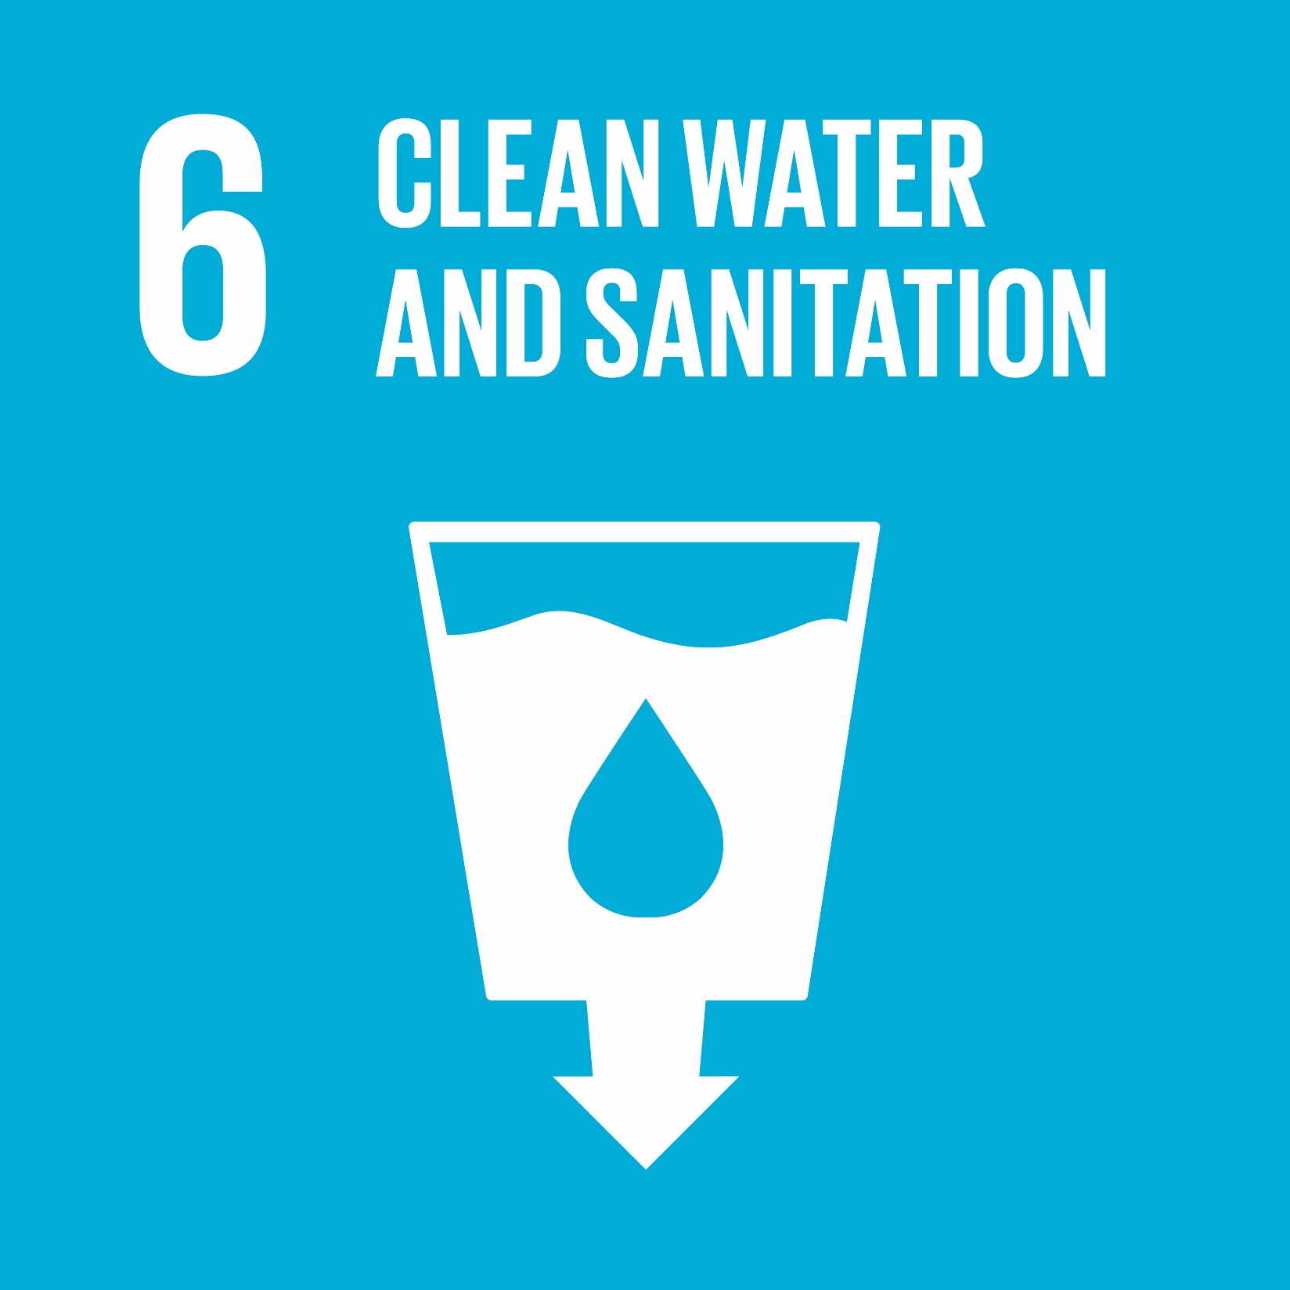
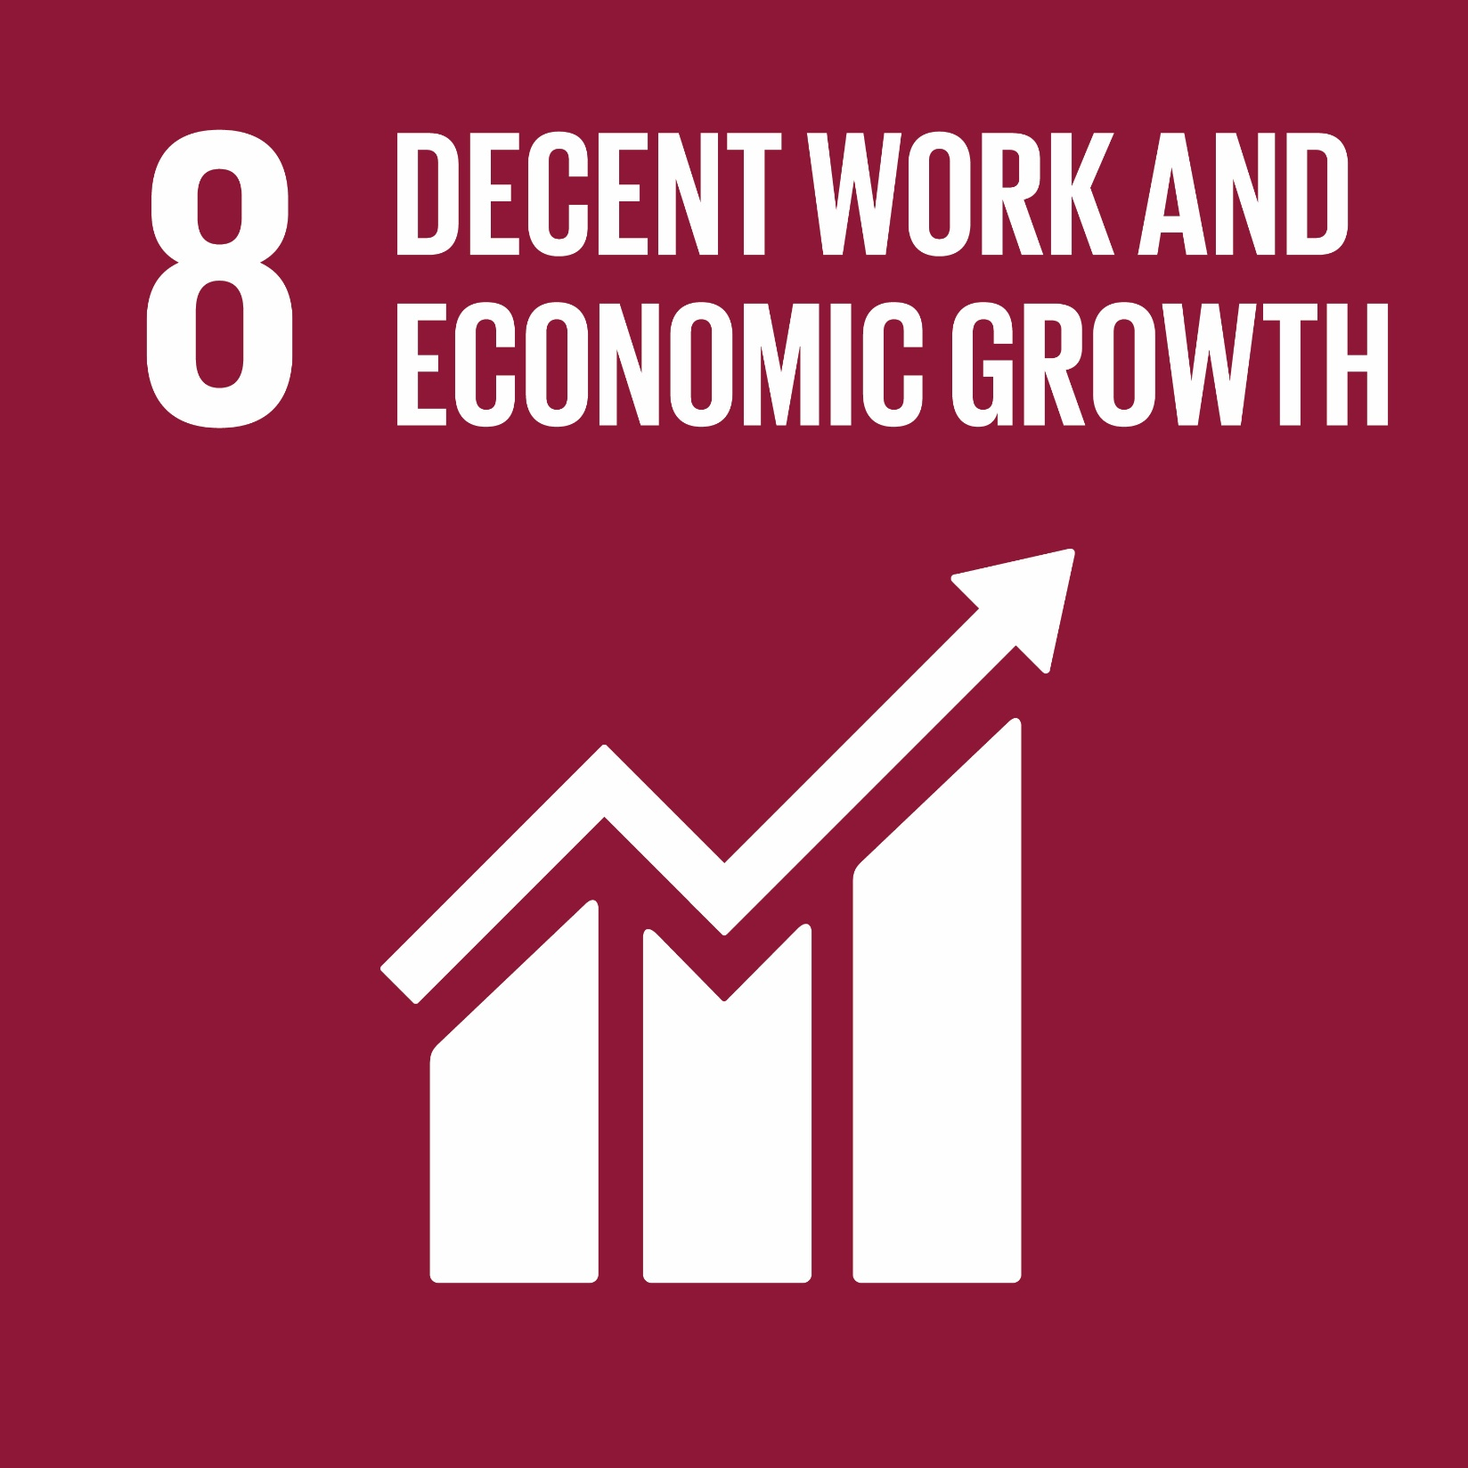
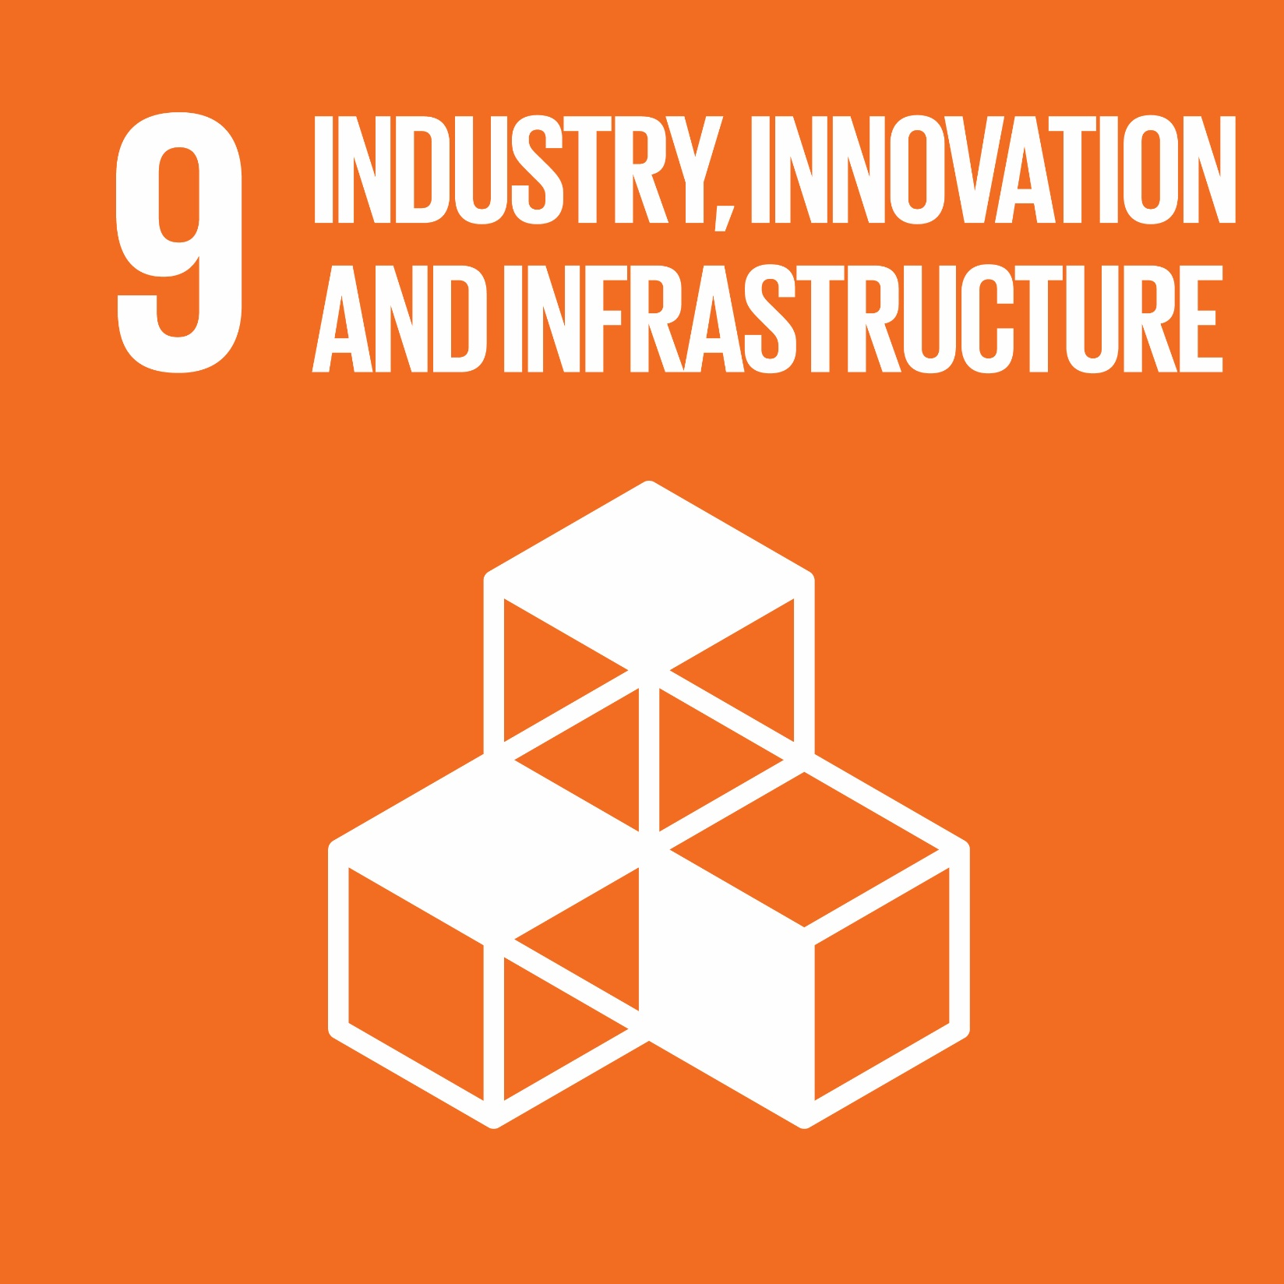
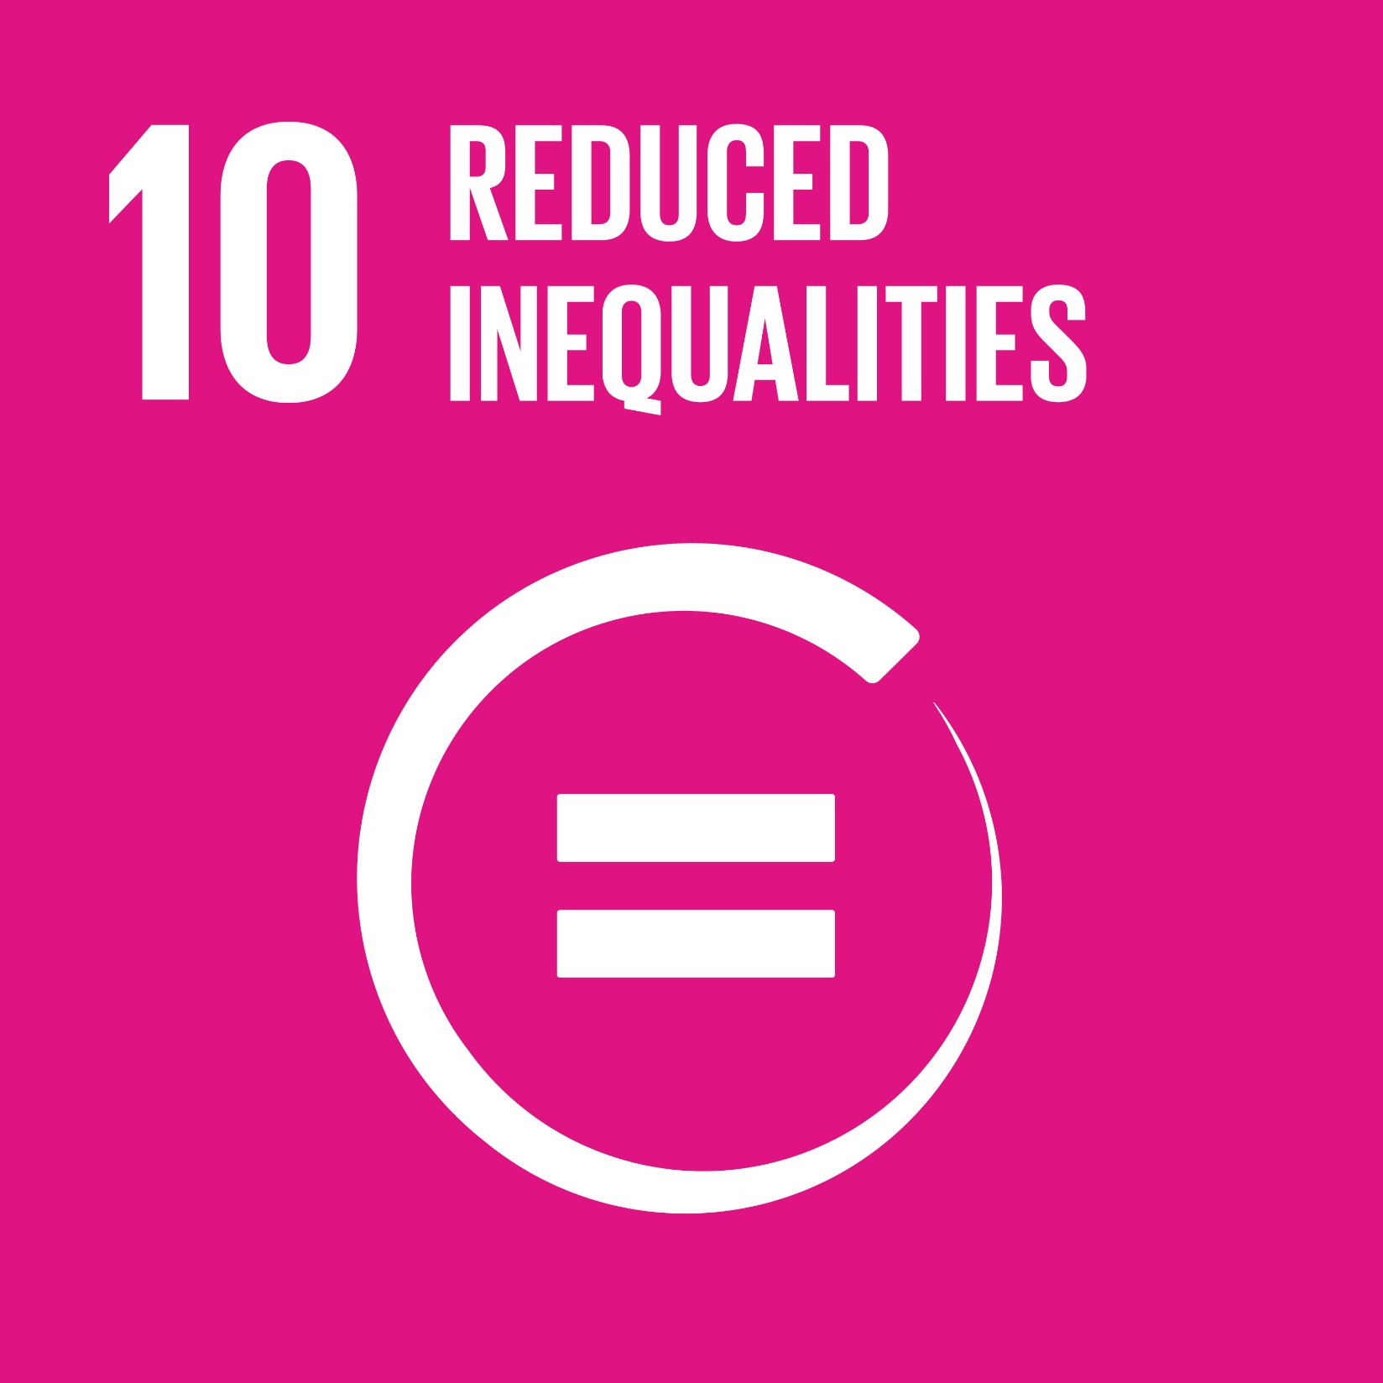

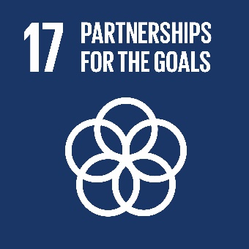
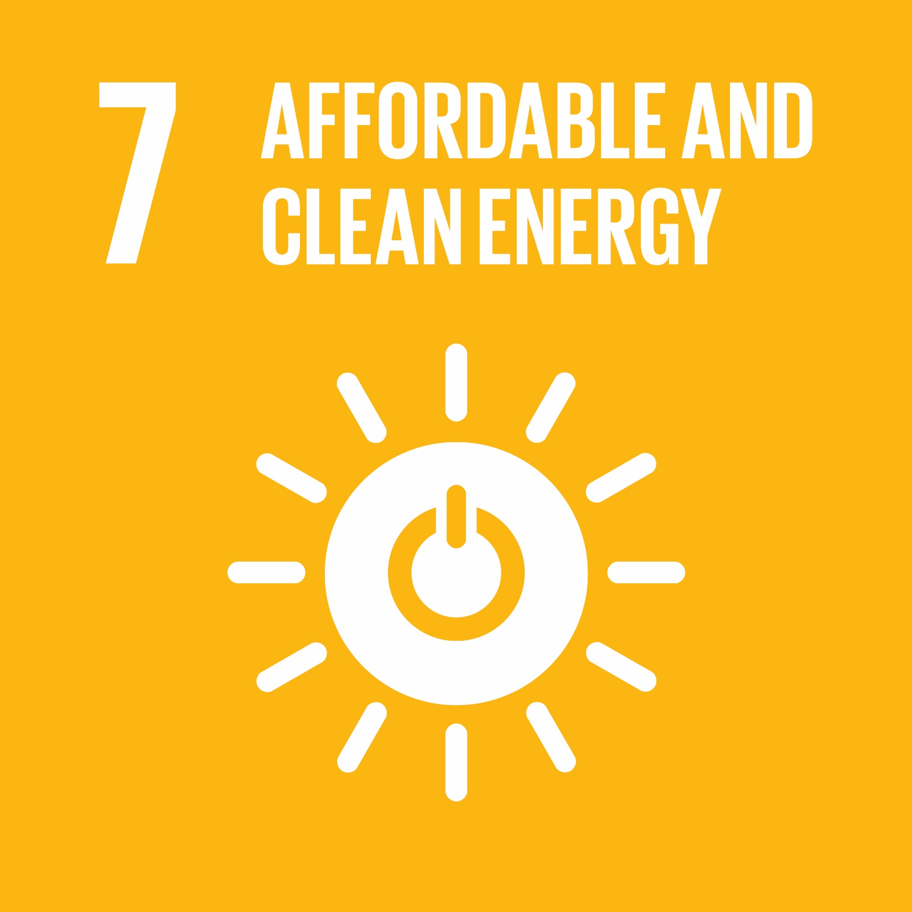
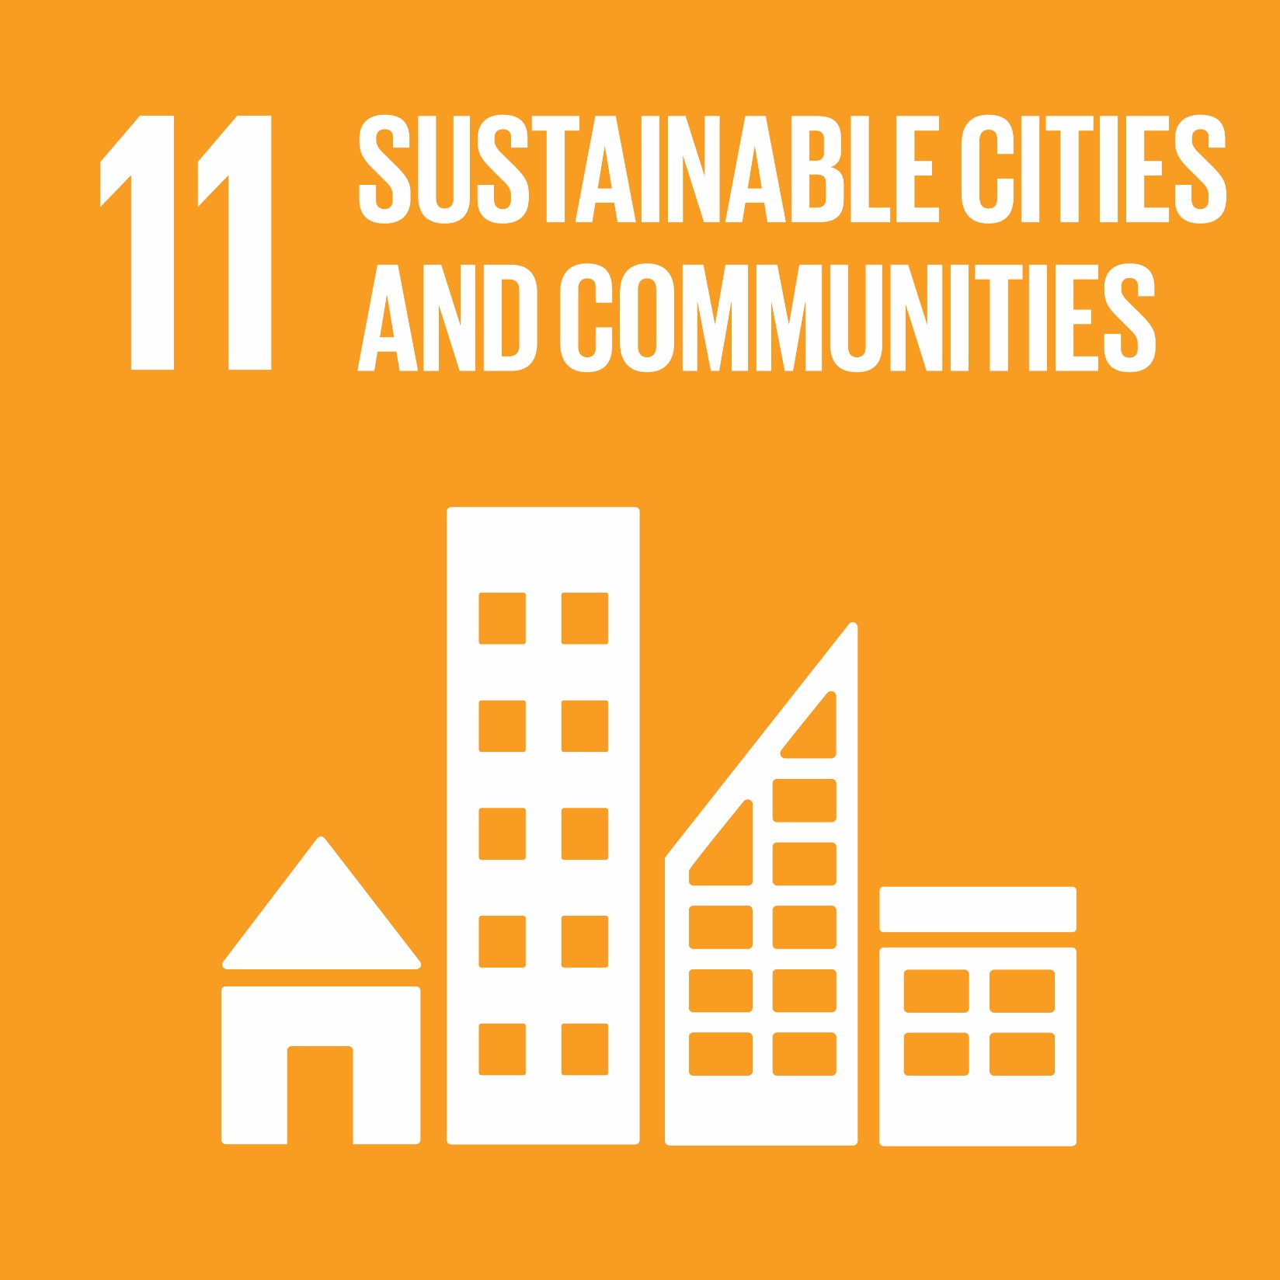
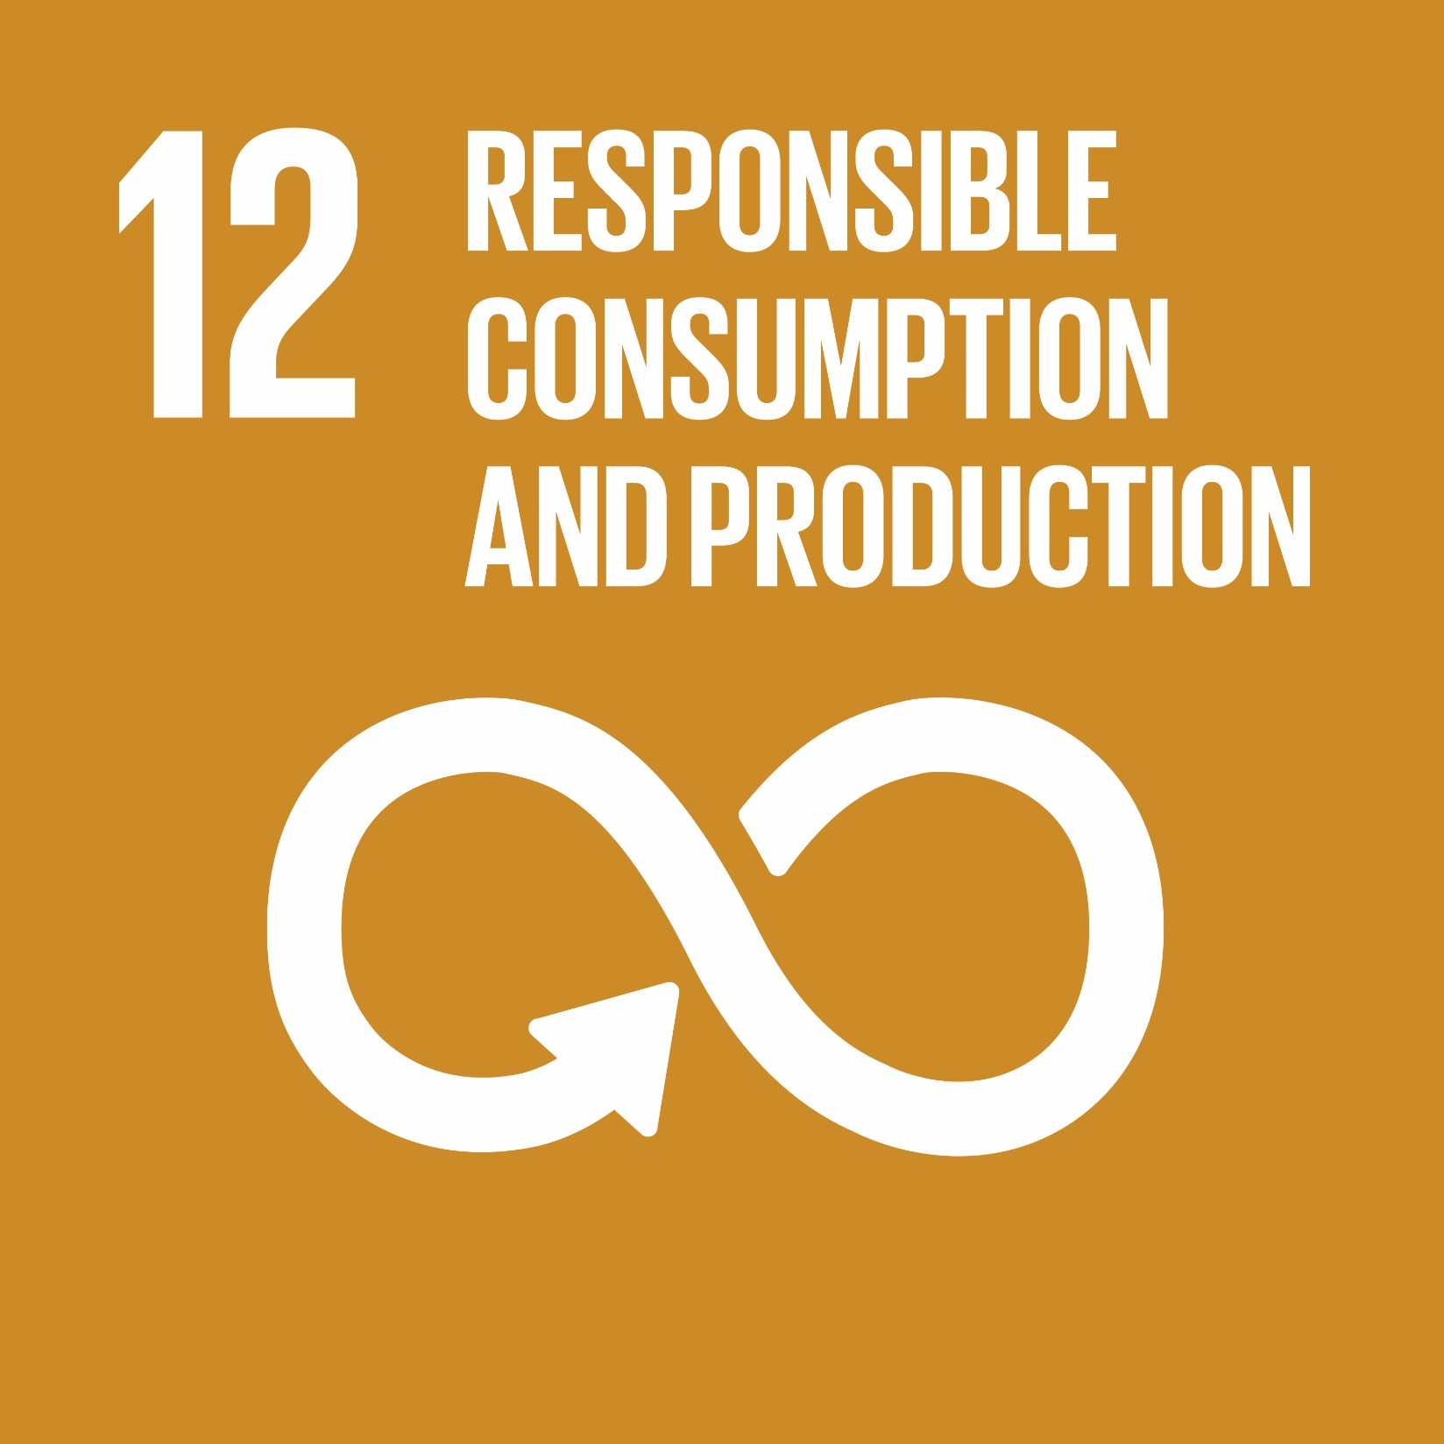
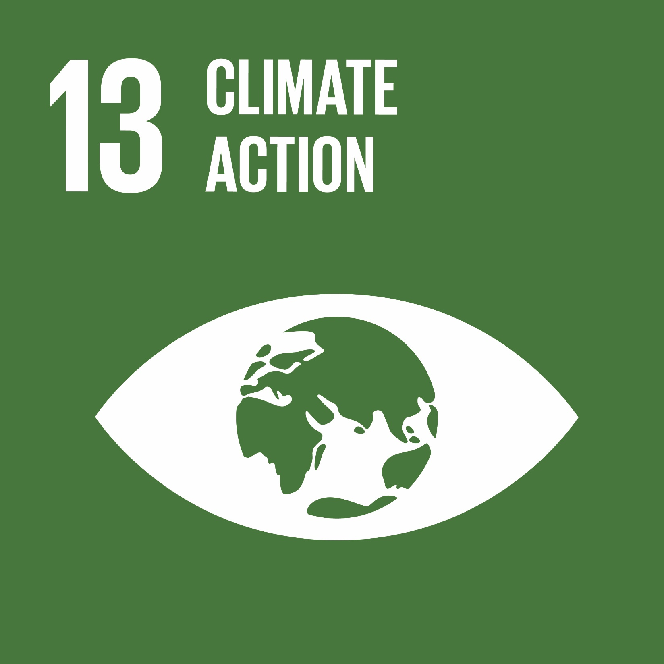
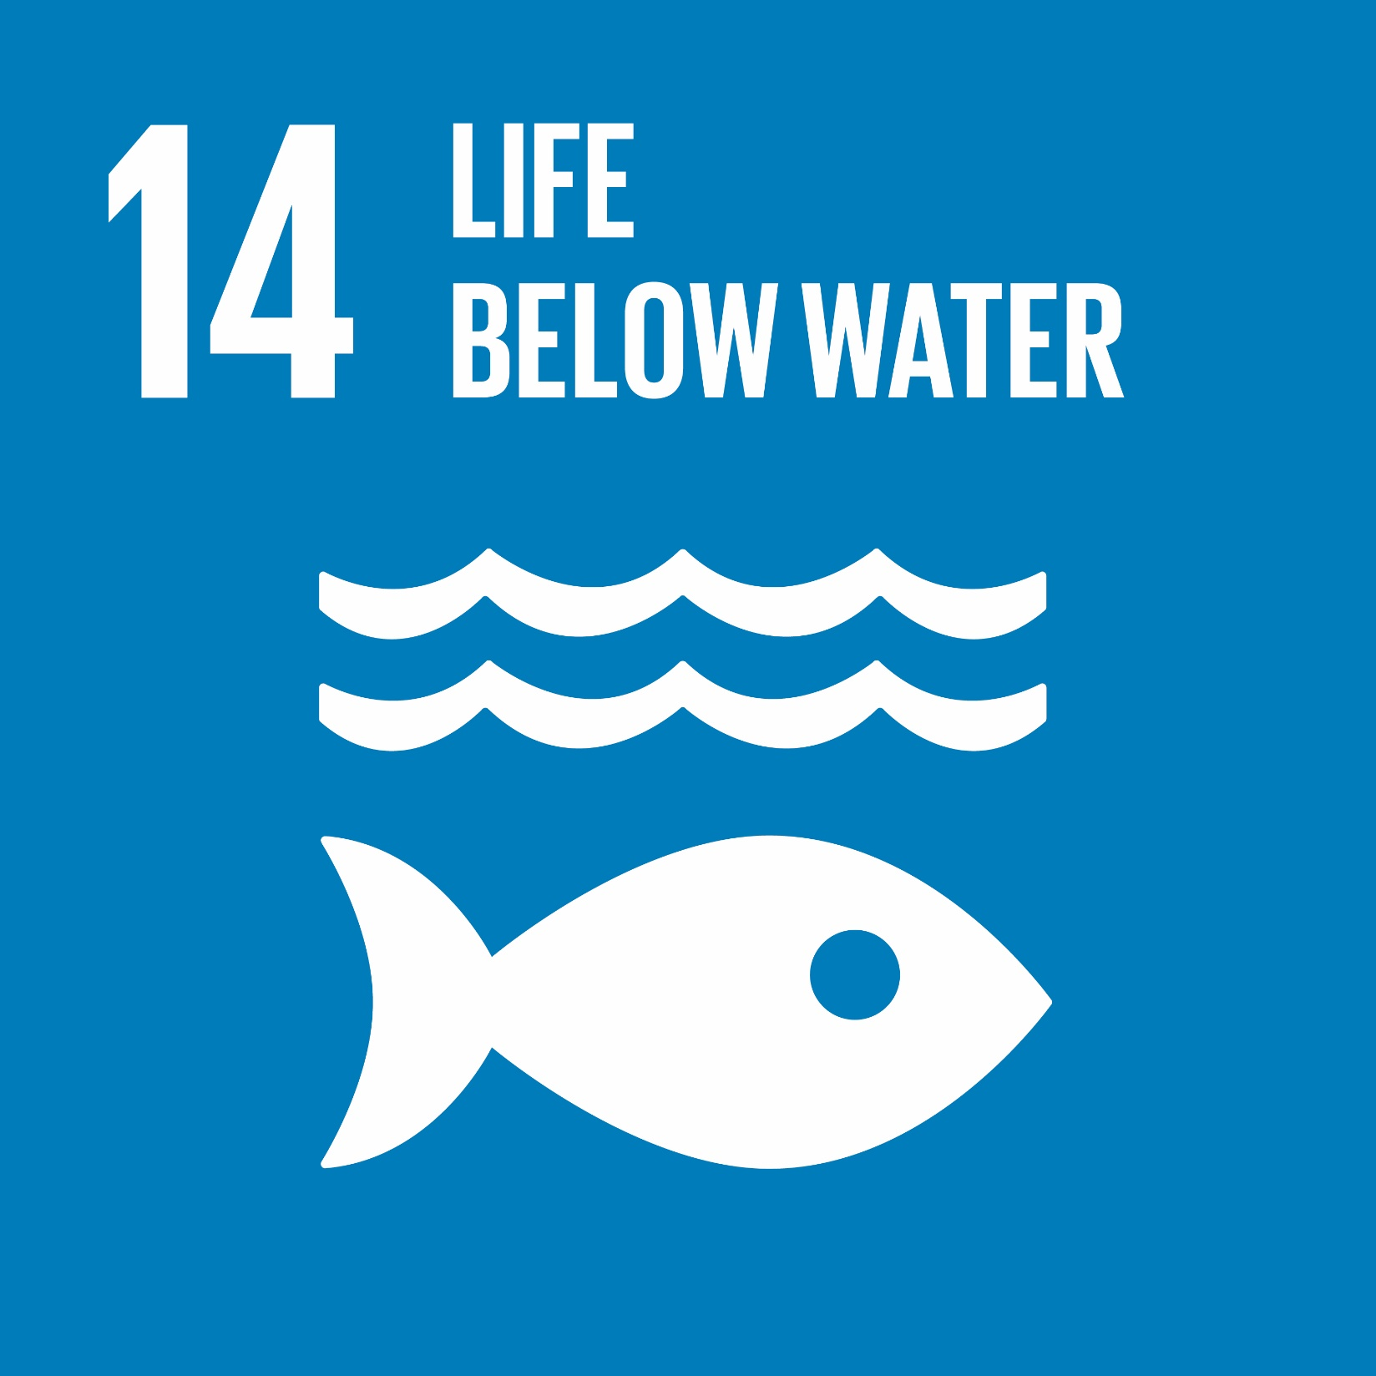
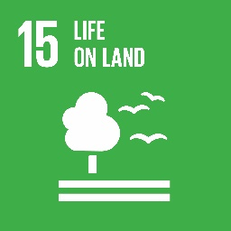
The Central Element of the UN 2030 Agenda is PEOPLE - the current and future generations
Economic and social development
Future generation – environmental management

Slide 6
Ports contribution to the Achievement of the Sustainable Development Goals
Economic and Social development
Ports should be operated efficiently and effectively, so as to reduce the transaction costs for trade, which in turn will contribute to the economic development of countries.
Unlike shipping with an international market to rely on, countries must develop their own ports to trade.
Ports usually provide employment, directly and indirectly, including in the logistic chain.
Ports contribute to countries’ economic and social stability.
Protect future generations through
Reduction in pollution (e.g. air, noise).
Reducing the impact of Energy consumption in ports.

Slide 7
The Key to the Success of the UN 2030 Agenda - EDUCATION
People should:
have the specialized and up to date knowledge and skills to manage the ports efficiently and effectively
Economic, legal, commercial management, technical and operational knowledge
The ability to apply the principles to solve practical problems
understand and appreciate the social dimension of port development
Socially responsibility for port companies
Decent working conditions, safety, health and welfare for port workers
People must:
be environmentally conscious
Implement international regulations on marine environment protection
Promote Green port policies and practices
be equipped with knowledge and expertise to address future challenges, including technology, innovation and digital disruption

Slide 8
Working with Future Generations for Port Sustainability - Role of WMU
Created by the IMO in 1983, World Maritime University has produced some 4,654 graduates from 167 countries with a Master’s degree on maritime affairs, with about 500 of them having specialized in the Port Management.
Many are working in senior positions in the port related areas around the world.
WMU’s work is directly related to SDG 4 and indirectly relevant to all other SDGs.
Examples of our work with respect to 3 selected SDGs:
SDG 5 on “gender equality”
SDG 7 on “sustainable energy for all”
SDG 14 on “sustainable use of oceans”

Slide 9
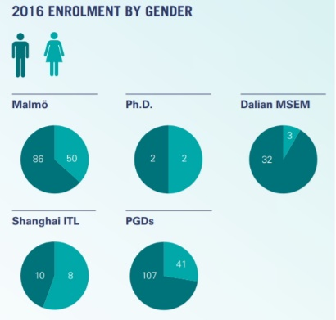
Equal Opportunities for Maritime and Port Education
Traditionally, maritime and port industries have been a male-dominated sector.
The situation has started to change and WMU has been a part of and an active contributor to this change.
Female Graduates in 2017
37% from
2.8%
in 1983
Average Age of Graduates in 2017
33

Slide 10
Providing the Cutting-Edge Knowledge to Future Managers on Sustainable Maritime Energy Management
As of 2015, WMU launched a new MSc. specialization and a PGDip programmes on “Maritime Energy Management”. This is the first such programme at the Master’s level in the world.
The purpose of these programmes provides the students with a comprehensive understanding of different aspects of maritime energy management across the field from shipping to oceans, and from ports to shipyards with a vision towards achieving a sustainable, energy efficient and low carbon maritime industry.
The enrolment of our MSc. Programme on Maritime Energy Management has been excellent and beyond our expectations. The first group of graduated in 2017.

Slide 11
Providing the Maritime Professionals with A Broader Vision of the Oceans
WMU has an MSc. specialization on “Ocean Sustainability, Governance & Management”. On 8 May 2018, a new Global Ocean Institute will be inaugurated at WMU.
The Global Ocean Institute will engage in multi-disciplinary scientific research in the marine field. This will enable WMU to be the research arm of the IMO and its maritime constituents, including the shipping industry and at the same time be the research centre to support SDGs implementation for the Ocean and Coasts – Goal 14.
Such an expanded research capacity for the University will require a network of partnerships with other maritime and ocean institutions, including IMO and the maritime industry, which could use WMU as the partner of choice for funded research projects.

Slide 12
Thank You

